Slide 1

AJAX and jQuery AJAX
AJAX Concepts, XMLHttpRequest, jQuery AJAX: $.ajax(), $.get(), $.post()
SoftUni Team
Technical Trainers
Software University
http://softuni.bg

Slide 2
Table of Contents
AJAX Concepts
XMLHttpRequest
jQuery AJAX
Low-Level Interface
Shorthand Methods
Global Ajax Event Handlers
Promise interface
Same-origin policy / CORS
AJAX – Examples
Accessing Firebase with AJAX

Slide 3
Have a Question?
sli.do #JSCORE

Slide 4

AJAX
Asynchronous JavaScript And XML

Slide 5
The conventional model
Based on complete HTML pages
Each user action required that a complete new page be loaded from the server
Bad user experience
All of the content had to be re-sent, even though only some of the information had changed
Inefficient bandwidth use

Slide 6
XMLHTTP
In 1996, the iframe tag was introduced by Internet Explorer
In 1998, the Microsoft Outlook Web App team developed the concept behind the XMLHttpRequest scripting object. It appeared as XMLHTTP in the second version of the MSXML library, which shipped with Internet Explorer 5.0 in March 1999
The functionality of the XMLHTTP ActiveX control in IE 5 was later implemented by Mozilla, Safari, Opera and other browsers as the XMLHttpRequest JavaScript object
Microsoft adopted the native XMLHttpRequest model as of Internet Explorer 7

Slide 7
What is AJAX?
AJAX == Asynchronous JavaScript And XML
A broad group of Web technologies that can be used to implement a Web application that communicates with a server in the background, without interfering with the current state of the page
HTML (or XHTML) and CSS for presentation
The Document Object Model (DOM) for dynamic display of and interaction with data
JSON or XML for the interchange of data, and XSLT for its manipulation
The XMLHttpRequest object for asynchronous communication
JavaScript to bring these technologies together

Slide 8
AJAX Use cases
Partial page rendering
Load HTML fragment and display it in a container
Web service
Load data as JSON / XML object and visualize it with JavaScript / jQuery
Manipulate domain objects
Using RESTful services

Slide 9




AJAX: Workflow
1. HTTP request (initial page load)
2. HTTP response (HTML page)
AJAX request
UI Interaction
AJAX response (asynchronous)
AJAX handler
Returns data as JSON / HTML
Web Client
Web Server
Modify the page DOM

Slide 10
AJAX request
AJAX response
Web Client
Web Server
Using the XMLHttpRequest Object

Slide 11
XMLHttpRequest – Standard API for AJAX
<button onclick="loadRepos()">Load Repos</button>
<div id="res"></div>
function loadRepos() {
let req = new XMLHttpRequest();
req.onreadystatechange = function() {
if (this.readyState == 4 && this.status == 200)
document.getElementById("res").textContent =
this.responseText;
};
req.open("GET",
"https://api.github.com/users/testnakov/repos", true);
req.send();
}
Check your code here: https://judge.softuni.bg/Contests/357

Slide 12
XMLHttpRequest – Standard API for AJAX
var xhr = new XMLHttpRequest();
xhr.open('GET', 'myservice/username?id=some-unique-id');
xhr.onload = function() {
if (xhr.status === 200) {
alert('User\'s name is ' + xhr.responseText);
}
else {
alert('Request failed. Returned status of ' + xhr.status);
}
};
xhr.send();

Slide 13
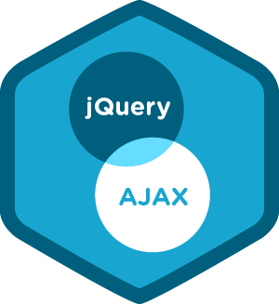
jQuery AJAX
Simplified AJAX Calls with jQuery

Slide 14
jQuery AJAX
jQuery simplifies how developers make AJAX calls
Low-Level Interface
jQuery.ajax() - Perform an asynchronous HTTP (Ajax) request.
jQuery.ajaxPrefilter() - Handle custom Ajax options or modify existing options before each request is sent and before they are processed by $.ajax().
jQuery.ajaxSetup() - Set default values for future Ajax requests. Its use is not recommended.
jQuery.ajaxTransport() - Creates an object that handles the actual transmission of Ajax data.

Slide 15
jQuery AJAX
Shorthand Methods
jQuery.get() - Load data from the server using a HTTP GET request.
jQuery.getJSON() - Load JSON-encoded data from the server using a GET HTTP request
jQuery.getScript() - Load a JavaScript file from the server using a GET HTTP request, then execute it.
jQuery.post() - Load data from the server using a HTTP POST request.
.load() - Load data from the server and place the returned HTML into the matched element.

Slide 16
jQuery AJAX
Global Ajax Event Handlers
.ajaxComplete() - Register a handler to be called when Ajax requests complete
.ajaxError() - Register a handler to be called when Ajax requests complete with an error
.ajaxSend() - Attach a function to be executed before an Ajax request is sent
.ajaxStart() - Register a handler to be called when the first Ajax request begins
.ajaxStop() - Register a handler to be called when all Ajax requests have completed
.ajaxSuccess() - Attach a function to be executed whenever an Ajax request completes successfully

Slide 17
jQuery VS Native XMLHttpRequest - GET
$.ajax('myservice/username', {
data: {
id: 'some-unique-id'
}
})
.then(
function success(name) {
alert('User\'s name is ' + name);
},
function fail(data, status) {
alert('Request failed. Returned status of ' + status);
}
);
var xhr = new XMLHttpRequest();
xhr.open('GET', 'myservice/username?id=some-unique-id');
xhr.onload = function() {
if (xhr.status === 200) {
alert('User\'s name is ' + xhr.responseText);
}
else {
alert('Request failed. Returned status of ' + xhr.status);
}
};
xhr.send();

Slide 18
jQuery VS Native XMLHttpRequest - POST
var newName = 'John Smith';
$.ajax('myservice/username?' + $.param({id: 'some-unique-id'}), {
method: 'POST',
data: {
name: newName
}
})
.then(
function success(name) {
if (name !== newName) {
alert('Something went wrong. Name is now ' + name);
}
},
function fail(data, status) {
alert('Request failed. Returned status of ' + status);
}
);
var newName = 'John Smith',
xhr = new XMLHttpRequest();
xhr.open('POST', 'myservice/username?id=some-unique-id');
xhr.setRequestHeader('Content-Type', 'application/x-www-form-urlencoded');
xhr.onload = function() {
if (xhr.status === 200 && xhr.responseText !== newName) {
alert('Something went wrong. Name is now ' + xhr.responseText);
}
else if (xhr.status !== 200) {
alert('Request failed. Returned status of ' + xhr.status);
}
};
xhr.send(encodeURI('name=' + newName));

Slide 19
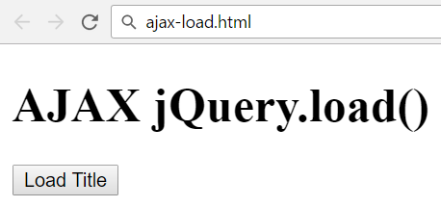
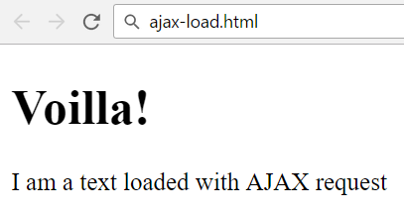
jQuery AJAX
Problem: create a page holding a button
Clicking the button should load an html fragment and display it inside a div

Slide 20
Solution: jQuery.load()
ajax-load.html
<div id="text">
<h1>AJAX jQuery.load()</h1>
<button onclick="loadTitle()">Load Title</button>
</div>
ajax-load.js
text.html
function loadTitle() {
$('#text').load("text.html");
}
<h1>Voilla!</h1>
<p>I am a text loaded with AJAX request</p>
Check your solution here: https://judge.softuni.bg/Contests/357
Submit in the judge the JS function loadTitle()

Slide 21

Same-origin policy / CORS

Slide 22
Same-origin policy
The same-origin policy is a critical security mechanism that restricts how a document or script loaded from one origin can interact with a resource from another origin. It helps isolate potentially malicious documents, reducing possible attack vectors
Two URLs have the same origin if the protocol, port (if specified), and host are the same for both
Internet Explorer has two major exceptions to the same-origin policy
Trust Zones
Port

Slide 23
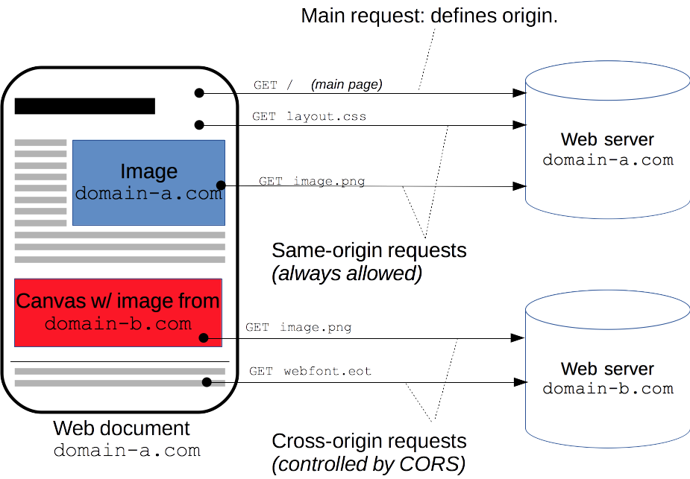

Slide 24
Cross-Origin Resource Sharing
Cross-Origin Resource Sharing (CORS) is a mechanism that uses additional HTTP headers to tell a browser to let a web application running at one origin (domain) have permission to access selected resources from a server at a different origin
Specification mandates that browsers "preflight" the request with an HTTP OPTIONS request method, and then, upon "approval" from the server, sending the actual request with the actual HTTP request method

Slide 25
Internet Explorer
Internet Explorer < 8 does not support cross domain ajax calls
Internet Explorer 8 and 9 are using XDomainRequest object
if(window.XDomainRequest){
var xdr = new XDomainRequest();
xdr.open("get", url);
xdr.onprogress = function () { };
xdr.ontimeout = function () { };
xdr.onerror = function () { };
xdr.onload = function() {
console.log(xdr.responseText);
};
setTimeout(function () {xdr.send();}, 0);
}

Slide 26
Same-origin policy
Scripts can execute AJAX requests
Either to their origin (same-origin policy)
Or when the remote server explicitly allows AJAX calls via CORS
Uses a special HTTP header: Access-Control-Allow-Origin
$(document).ajaxError(function(event, req, settings) {
$('#text').text(`Error loading data: ${req.status} (${req.statusText})`);
});
function loadTitle() {
$('#text').load("https://softuni.bg");
}
This cross-origin AJAX request will fail due to missing CORS headers

Slide 27
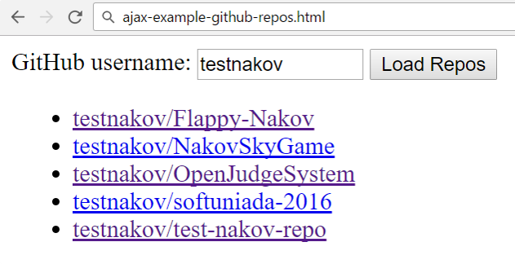
Problem: Load GitHub Repos with AJAX
GitHub username:
<input type="text" id="username" value="testnakov" />
<button onclick="loadRepos()">Load Repos</button>
<ul id="repos"></ul>
<script>
function loadRepos() {
// AJAX call …
}
</script>

Slide 28
Solution: Load GitHub Repos with AJAX
function loadRepos() {
$("#repos").empty();
let url = "https://api.github.com/users/" +
$("#username").val() + "/repos";
$.ajax({ url,
success: displayRepos,
error: displayError
});
function displayRepos(respos) { … }
function displayError(err) { … }
}

Slide 29
Solution: Load GitHub Repos with AJAX (2)
function displayRepos(respos) {
for (let repo of respos) {
let link = $('<a>').text(repo.full_name);
link.attr('href', repo.html_url);
$("#repos").append($('<li>').append(link));
}
}
function displayError(err) {
$("#repos").append($("<li>Error</li>"));
}
Check your solution here: https://judge.softuni.bg/Contests/357

Slide 30

AJAX – Examples
Using jQuery to Access REST APIs

Slide 31
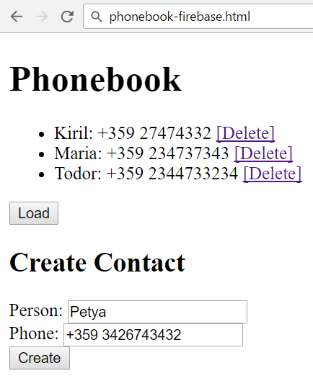
Problem: Phonebook App in Firebase
Create a mini phonebook JS front-end app
Hold your data in Firebase
Disable the authentication to simplify your work
Implement "list phones", "add phone", "delete phone"

Slide 32
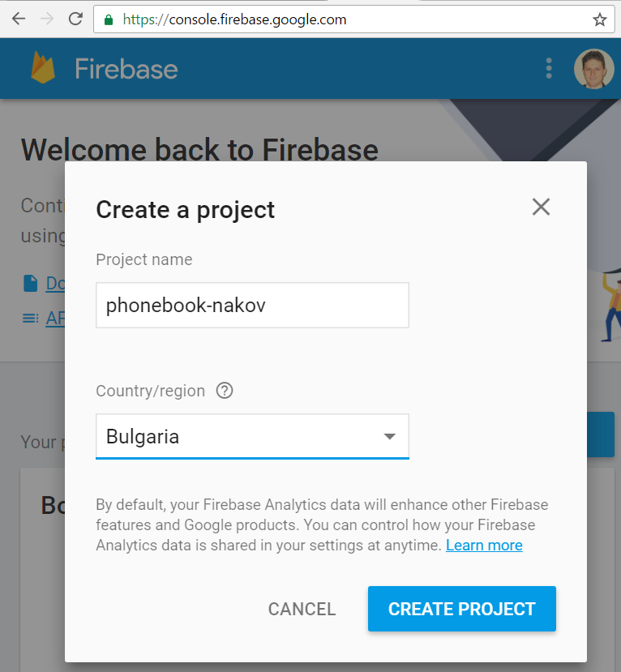
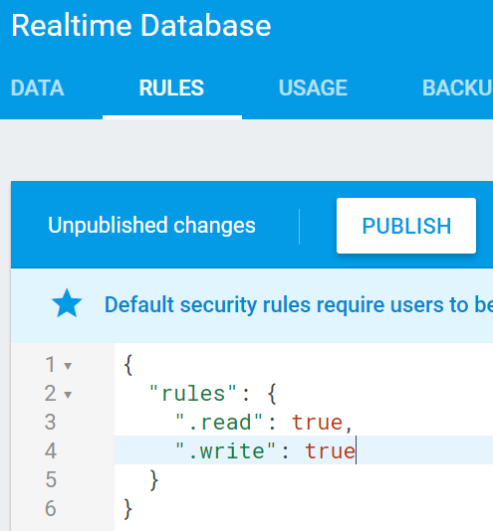
Solution: Setup a Firebase DB
Open https://console.firebase.google.com/
Create a new project
Enable public read / write access

Slide 33
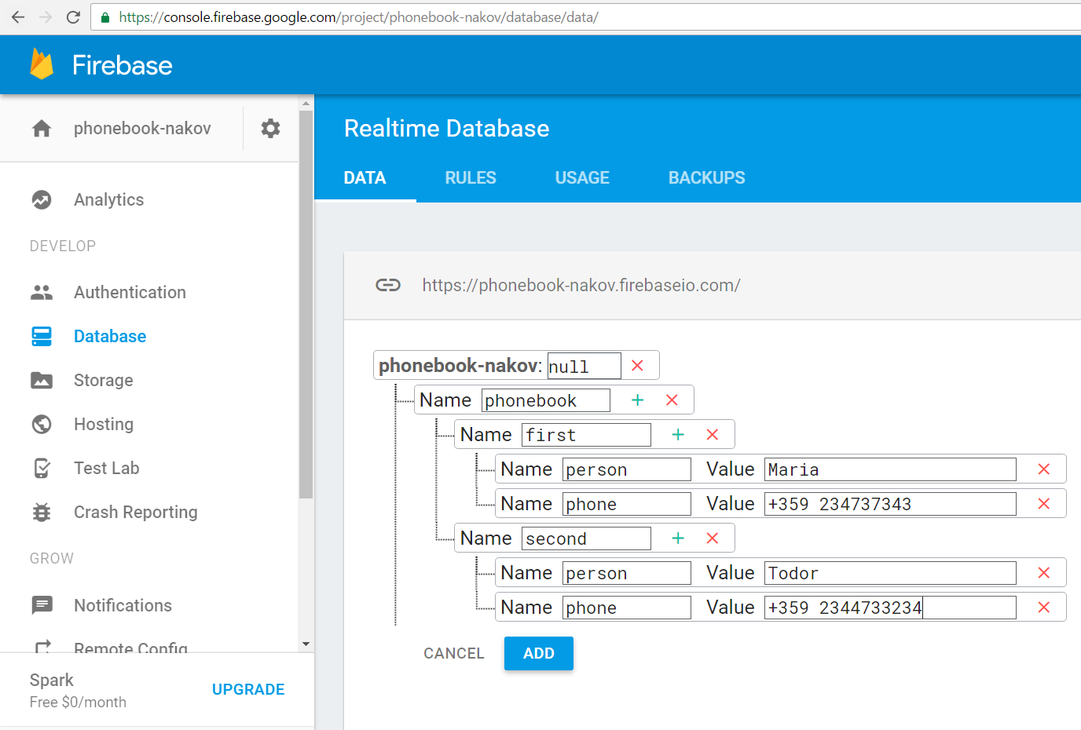
Solution: Add Sample Data in Firebase

Slide 34
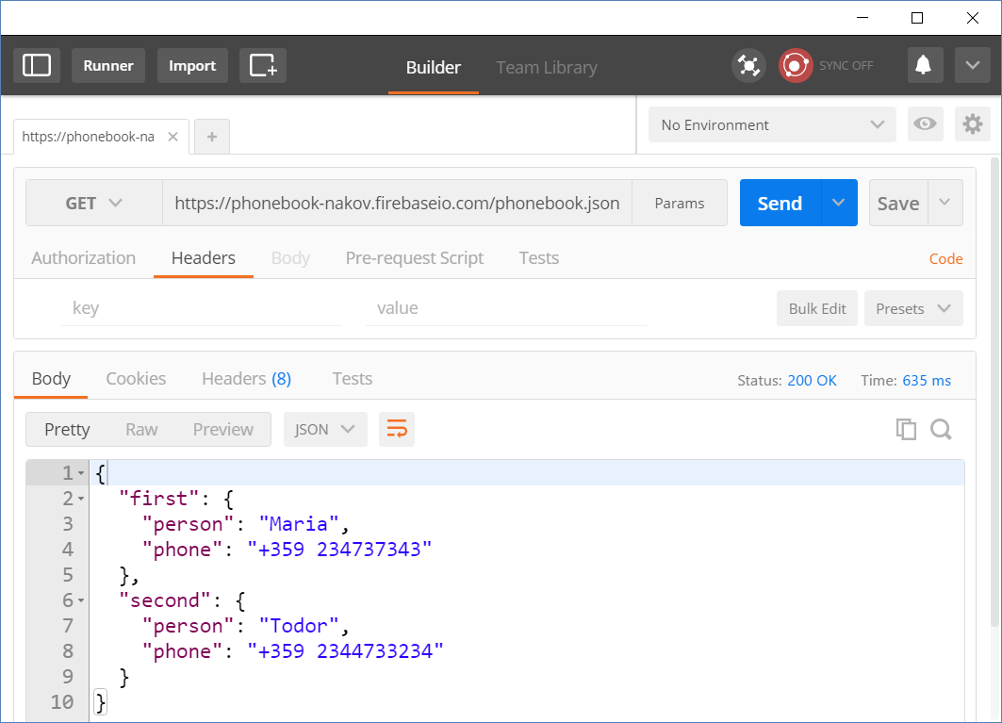
Solution: Test Your REST Service

Slide 35
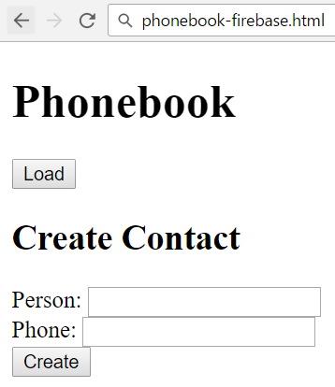
Solution: Phonebook in Firebase – HTML
<h1>Phonebook</h1>
<ul id="phonebook"></ul>
<button id="btnLoad">Load</button>
<h2>Create Contact</h2>
Person: <input type="text" id="person" />
<br>
Phone: <input type="text" id="phone" />
<br>
<button id="btnCreate">Create</button>

Slide 36
Solution: Phonebook in Firebase – JS Code
$(function () {
$('#btnLoad').click(loadContacts);
$('#btnCreate').click(createContact);
let baseServiceUrl =
'https://phonebook-nakov.firebaseio.com/phonebook';
function loadContacts() { … }
function displayContacts(contacts) { … }
function displayError(err) { … }
function createContact() { … }
function deleteContact(key) { … }
});

Slide 37
Solution: Phonebook in Firebase – JS Code
function loadContacts() {
$("#phonebook").empty();
$.get(baseServiceUrl + '.json')
.then(displayContacts)
.catch(displayError);
}
function displayError(err) {
$("#phonebook").append($("<li>Error</li>"));
}

Slide 38
Solution: Phonebook in Firebase – JS Code
function displayContacts(contacts) {
for (let key in contacts) {
let person = contacts[key]['person'];
let phone = contacts[key]['phone'];
let li = $("<li>");
li.text(person + ': ' + phone + ' ');
$("#phonebook").append(li);
li.append($("<button>Delete</button>")
.click(deleteContact.bind(this, key)));
}
}
Bind the event handler with the current key

Slide 39
Solution: Phonebook in Firebase – JS Code
function createContact() {
let newContactJSON = JSON.stringify({
person: $('#person').val(),
phone: $('#phone').val()
});
$.post(baseServiceUrl + '.json', newContactJSON)
.then(loadContacts)
.catch(displayError);
$('#person').val('');
$('#phone').val('');
}

Slide 40
Solution: Phonebook in Firebase – JS Code
The correct contact key will come as parameter (due to binding)
function deleteContact(key) {
let request = {
method: 'DELETE',
url: baseServiceUrl + '/' + key + '.json'
};
$.ajax(request)
.then(loadContacts)
.catch(displayError);
}
Check your solution here: https://judge.softuni.bg/Contests/357

Slide 41


Practice: jQuery AJAX
Live Exercises in Class (Lab)

Slide 42

Summary
Arrow functions ≈ short function syntax
AJAX sends asynchronous HTTP requests from JS
jQuery simplifies how developers use AJAX
$.ajax({ url, method: 'GET',
success: displayRepos,
error: displayError
});
function displayRepos(respos) { … }
function displayError(err) { … }
}

Slide 43
https://softuni.bg/trainings/2082/js-applications-november-2018

Slide 44













SoftUni Diamond Partners

Slide 45





SoftUni Organizational Partners

Slide 46




Trainings @ Software University (SoftUni)
Software University – High-Quality Education and Employment Opportunities
softuni.bg
Software University Foundation
http://softuni.foundation/
Software University @ Facebook
facebook.com/SoftwareUniversity
Software University Forums
forum.softuni.bg

Slide 47

License
This course (slides, examples, demos, videos, homework, etc.) is licensed under the "Creative Commons Attribution-NonCommercial-ShareAlike 4.0 International" license

